Slide 1

Topic :-
Self Controlling Vehicle Using PID Controller And Estimation Of Traffic Congestion

Slide 2
Guided By -
Jetendra Joshi Sir
Group Members -
Sujoy Roy
Anshuman Singh
Rajat Singh
Sachin Reddy
Rajat Sinha

Slide 3
Rational of the work
Objectives
Methodology
Review of Literature
Preview

Slide 4
Rational of the work
VANET
PID Controller
Traffic congestion Control

Slide 5
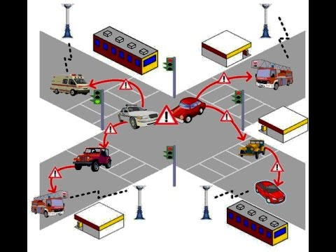
VANET
Image Courtesy - https://www.google.co.in/search?q=vanet&source=lnms&tbm=isch&sa=X&ved=0ahUKEwi865jX2uHRAhVEO48KHYNQB78Q_AUICCgB&biw=1304&bih=678#imgrc=yCTSf4K-VDvN3M%3A

Slide 6
Applications of vanet
Active-road safety applications
Traffic efficiency and management applications
Comfort and infotainment applications

Slide 7
Self Driven Automated Car
These vehicles are capable of sensing it’s environment and navigating without human input
Capable of detecting surroundings using techniques like radar, GPS and computer vision.
Helps in reduction of traffic collision

Slide 8
video

Slide 9
Self driven cars in india

Slide 10
What is PID ?
Proportional-integral-derivative (PID) control is the most common controller used in industry and has been universally accepted in industrial control.
The popularity of PID controllers can be attributed partly to their robust performance in a wide range of operating conditions.

Slide 11
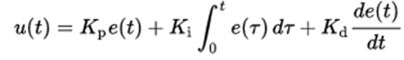
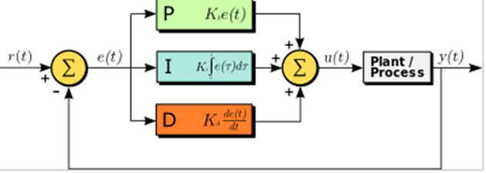
Working
A PID controller continuously calculates an error value as the difference between a desired set point and a measured process variable and applies correction based on proportional, integral and derivative terms.
The new value determined by a weighted sum.
Kp=proportional gain
Ki=integral gain
Kd=derivative gain
E(t)=error=setpoint-process variable

Slide 12
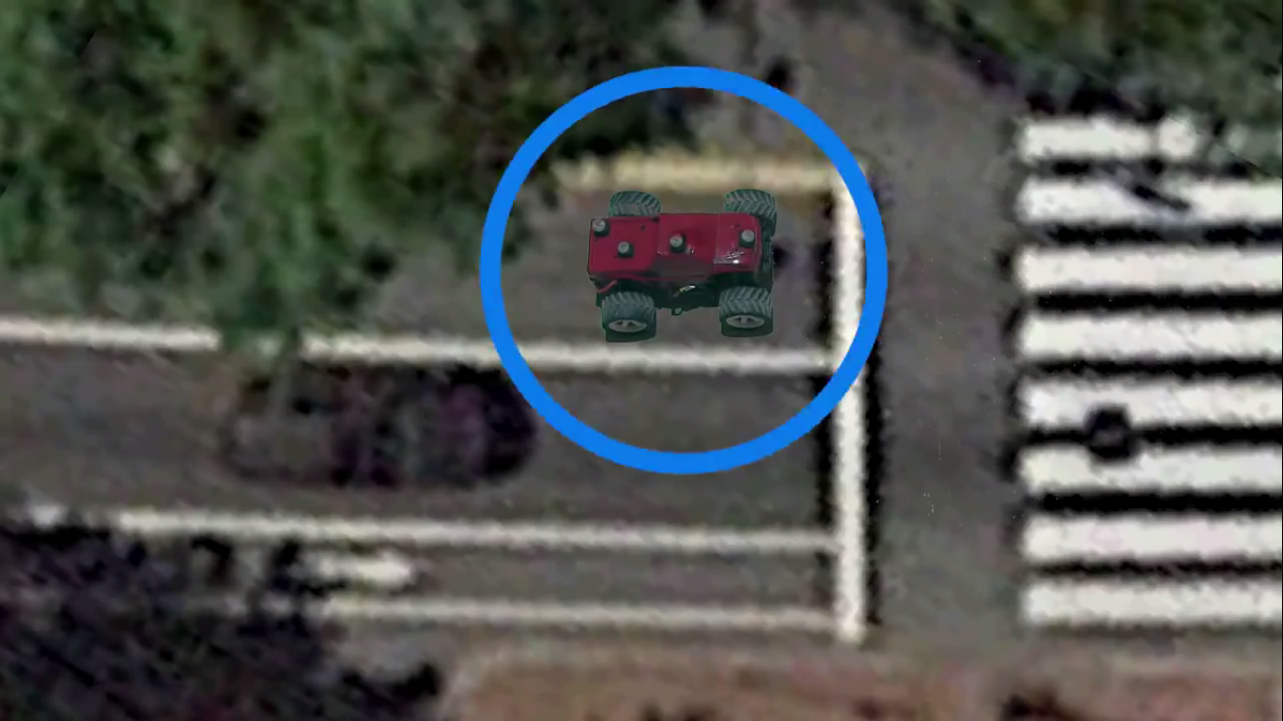
Localization of vehicle
Image courtesy:-https://www.youtube.com/watch?v=4Y7zG48uHRo&t=61s

Slide 13
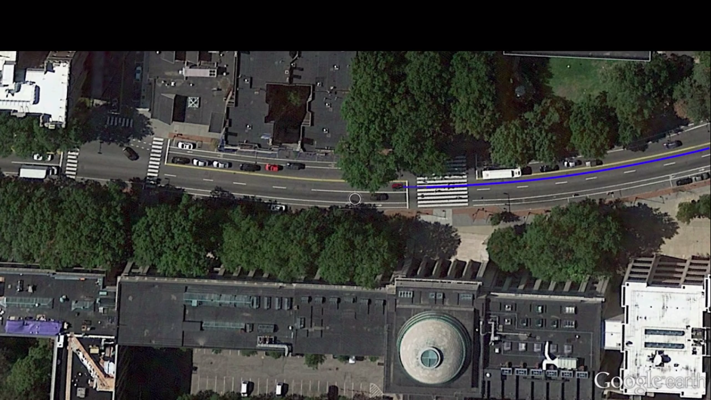
Defines its trajectory to destination
Image courtesy:-https://www.youtube.com/watch?v=4Y7zG48uHRo&t=61s

Slide 14
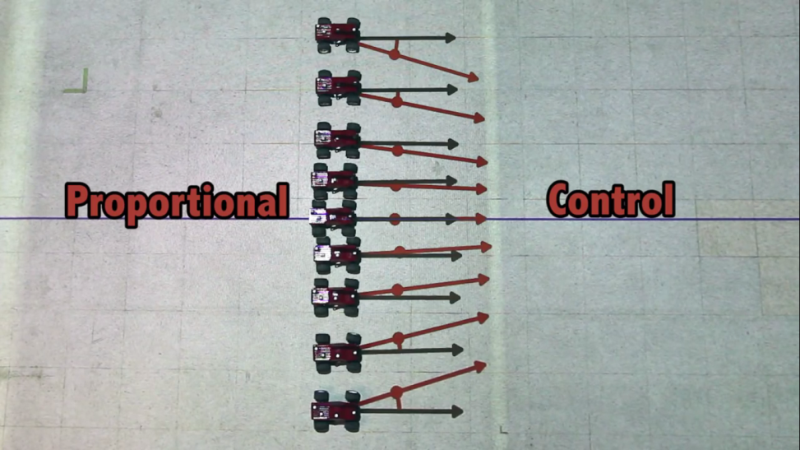
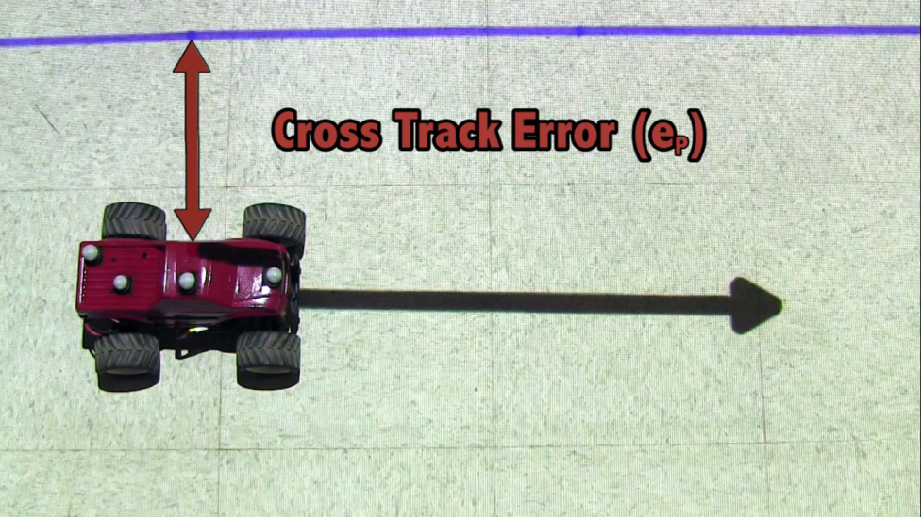
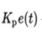
Proportional Control
P=
Image courtesy:-https://www.youtube.com/watch?v=4Y7zG48uHRo&t=61s

Slide 15
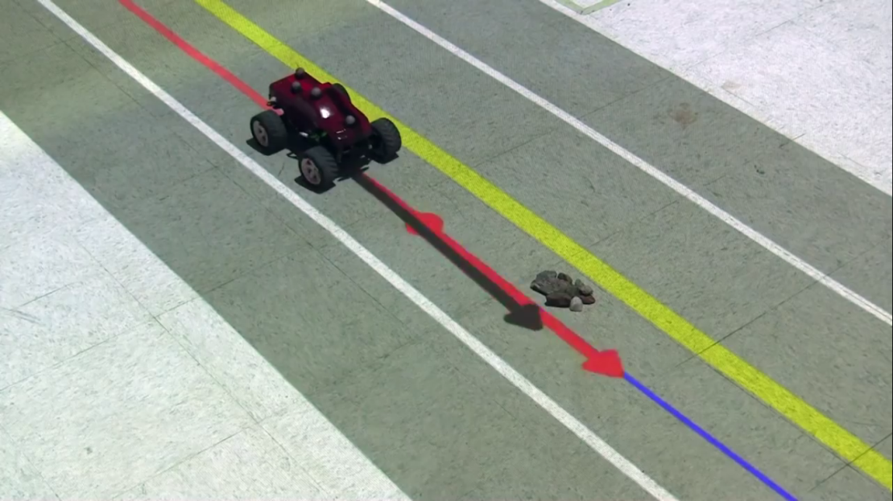
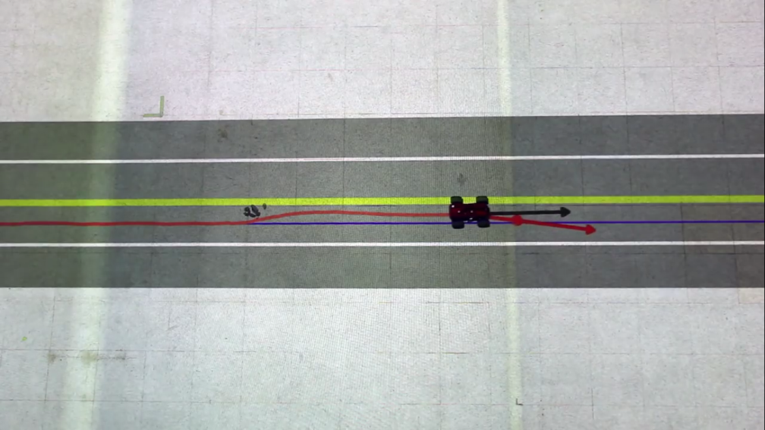
Integral Term
Image courtesy:-https://www.youtube.com/watch?v=4Y7zG48uHRo&t=61s

Slide 16
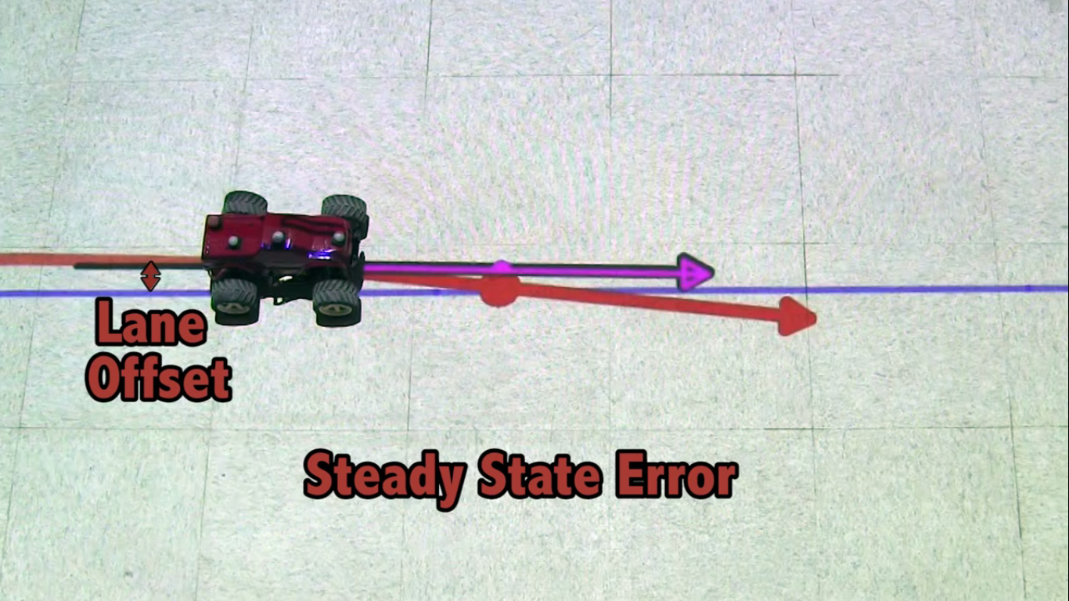
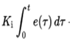
The car deviates from the trajectory which is called lane offset.
I=
Image courtesy:-https://www.youtube.com/watch?v=4Y7zG48uHRo&t=61s

Slide 17
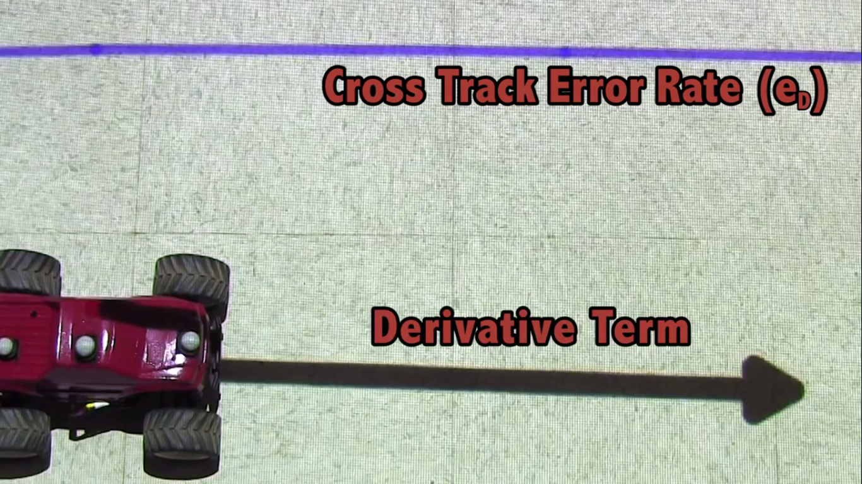
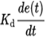
Derivative Term
Speed of the vehicle deviates it from the trajectory.
D =
Image courtesy:-https://www.youtube.com/watch?v=4Y7zG48uHRo&t=61s
Notes:
How fast moving is a perpendicular direction.

Slide 18
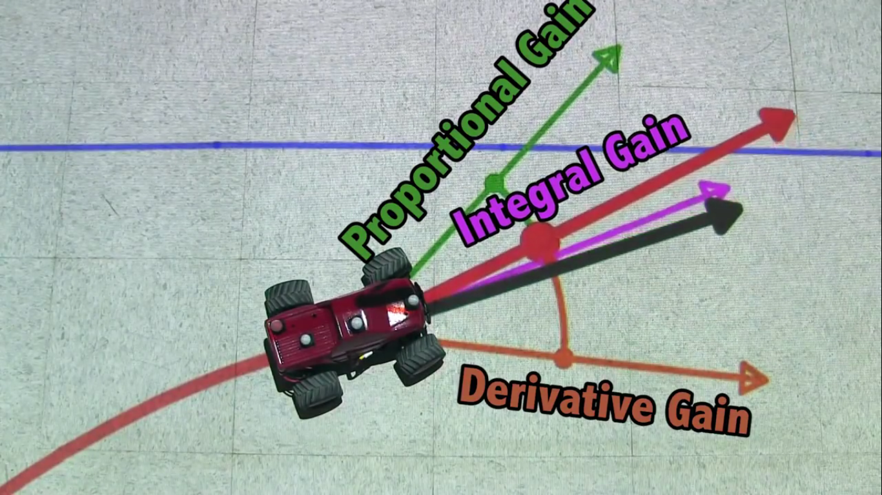
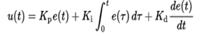
Image courtesy:-https://www.youtube.com/watch?v=4Y7zG48uHRo&t=61s

Slide 19
Why PID ?
The advantage of PID controller is its feasibility and easy to be implemented.
The PID gain can be designed just based on the system tracking error if the system parameters are unknown.
Easy to test and troubleshoot.

Slide 20
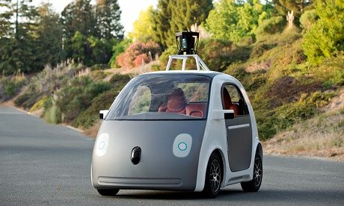
Google self driven car
Image Courtesy - https://www.google.co.in/search?q=google+self+control+car&espv=2&biw=1304&bih=678&source=lnms&tbm=isch&sa=X&ved=0ahUKEwiC2P20m-TRAhXCv48KHeRYAlgQ_AUIBygC#imgrc=Z-Croalv6QONLM%3A

Slide 21
Traffic Congestion from gps traces

Slide 22
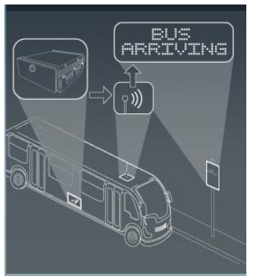
Field Implementations of Bus Arrival Prediction Systems
Bus time
Estimated time of arrival predictions
Next bus
Parking lot

Slide 23
Travel Recommendations from GPS traces
Two types
First is a generic one that recommends a user with top interesting locations and travel sequences in a geo-spatial regions.
Second is a personalized recommendation that provides an individual with locations matching his/her travel preferences.

Slide 24
Objective
To study the implementation of PID controller and self driven automated cars.
To study the strategy for determining the traffic congestion of road, and its application scenario in estimation of bus travel time and parking slots allotment.

Slide 25
METHODOLOGY
To Study the architecture of VANET.
To Study the use of PID controller in Self Automated Car.
To Study and formulate strategy in determining the Traffic Detection.
To analyze the method of reducing the Traffic Congestion on roads.
To Calculate the Travel Time Estimation of Vehicles.

Slide 26
Review of Literature
[1] Anas Mahmoud, “Non-Range Based Cooperative Localization for VANETs in Urban Environments”,
Queen's University Kingston, Ontario, Canada, August 2015.
[2] Dr. Lelitha Vanajakshi and Dr. Shankar C. Subramanian , “Development of a Real Time Bus Arrival Time
Prediction System under Indian Traffic Conditions”, IIT Madras, June 2016.
[3] Moussaoui Samira and Haouari Noureddine, “Efficient Local Density Estimation Strategy for VANETs”,
Algiers, Algeria, 2013.
[4] MARIAM ELAZAB, “Integrated cooperative localization in vanets for GPS denied environments”,
Queen’s University Kingston, Ontario, Canada, October 2015.
[5] Ang, K.H. and Chong, G.C.Y. and Li, Y. , “PID control system analysis, design, and technology”, IEEE
Transactions on Control Systems Technology JULY 2005

Slide 27
Thank YOU

